Slide 1
Data Visualization and Bias
Vanessa LoBue
Jamil Bhanji
with a little help from Andy Field

Slide 2
Aims
Assumptions of parametric tests based on the normal distribution
Know how to correct problems in the data
Data visualization techniques

Slide 3
Assumptions
Parametric tests based on the normal distribution assume:
Additivity and linearity
Normality (of what?)
Homogeneity of Variance
Independence

Slide 4
Additivity and Linearity
The outcome variable is linearly related to any predictors
If you have several predictors then their combined effect is best described by adding their effects together
If this assumption is not met then your model is invalid

Slide 5
Normally Distributed
The normal distribution is relevant to:
Parameters
Confidence intervals around a parameter
Null hypothesis significance testing

Slide 6
When does the assumption of normality matter?
In small samples
The central limit theorem allows us to forget about this assumption in larger samples
In practical terms, as long as your sample is fairly large (> N = 30), outliers (non-linearity & heterogeneity) are a much more pressing concern than normality
However, non-normal residuals may occur along with violations of linearity and or homogeneity of variance …

Slide 7
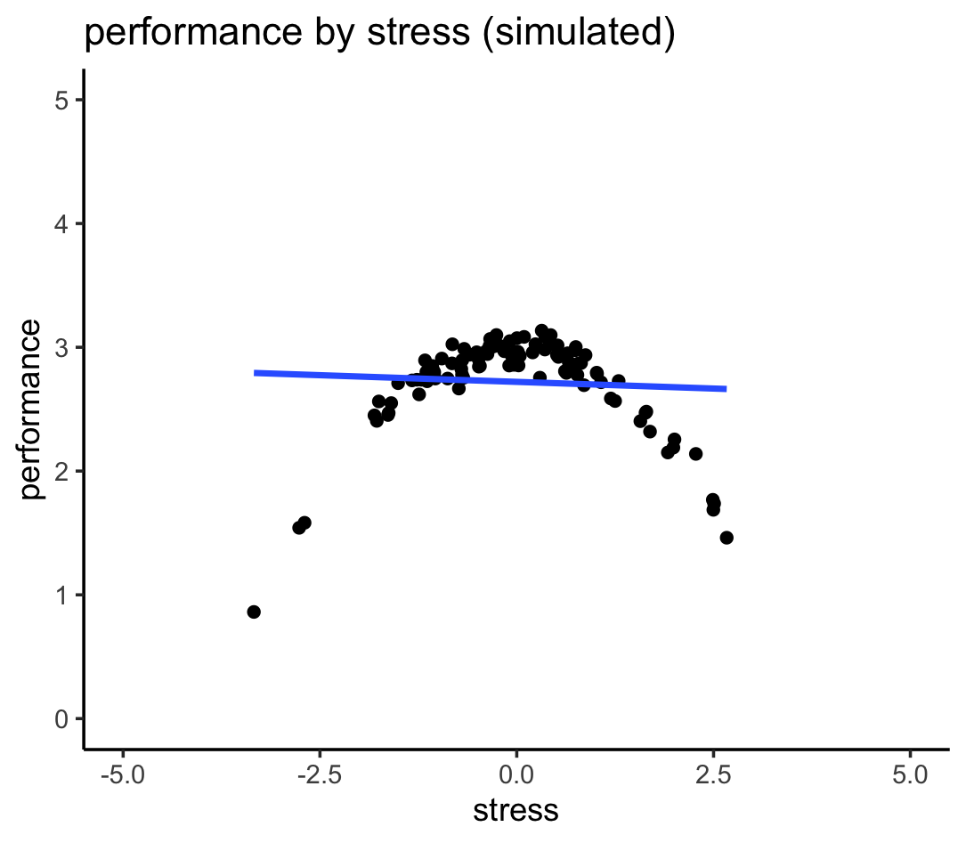
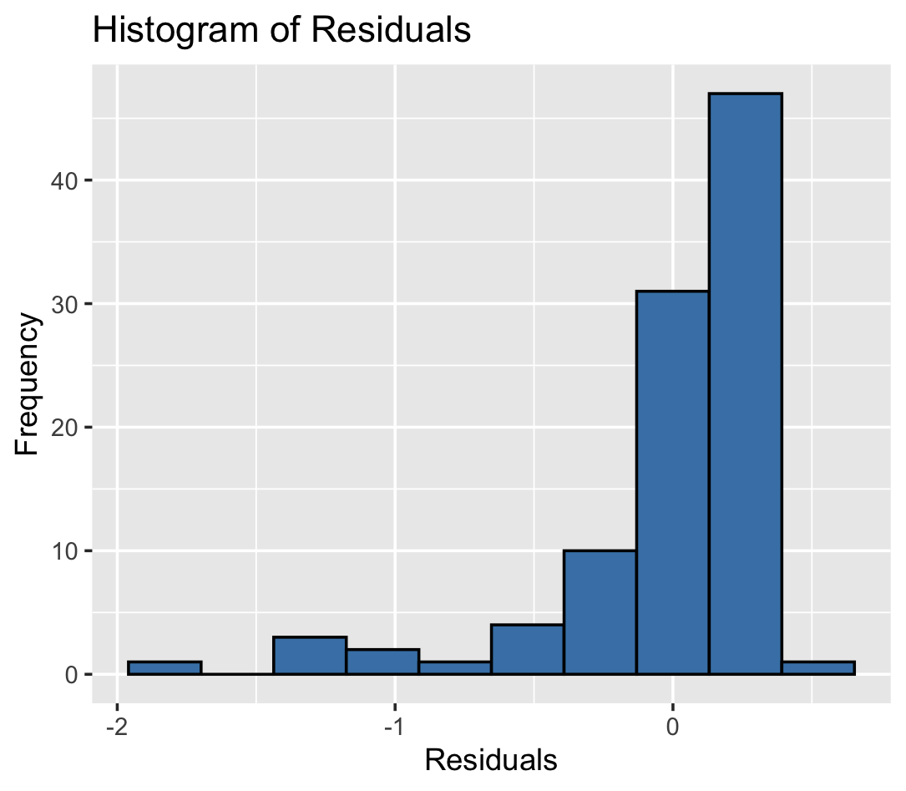
A well-known nonlinear association

Slide 8
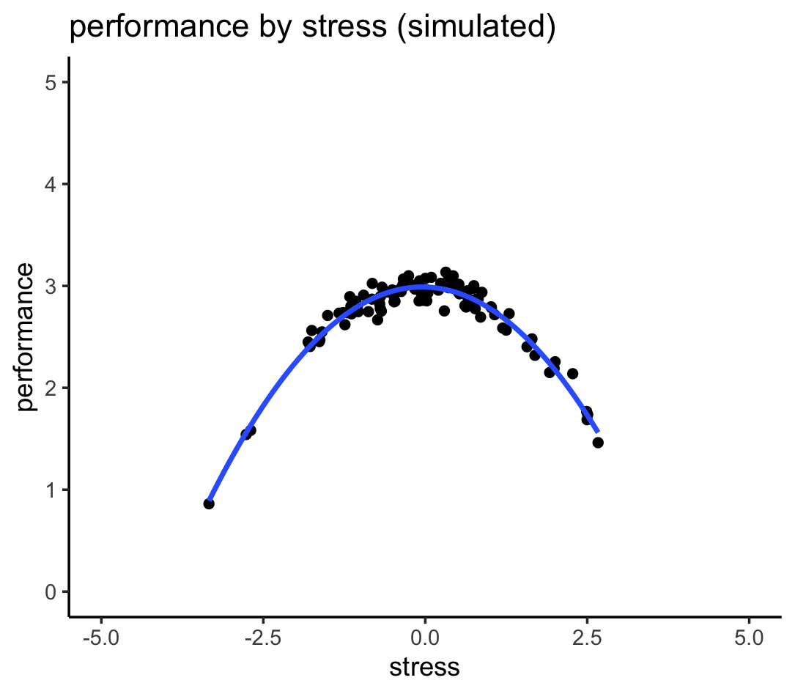
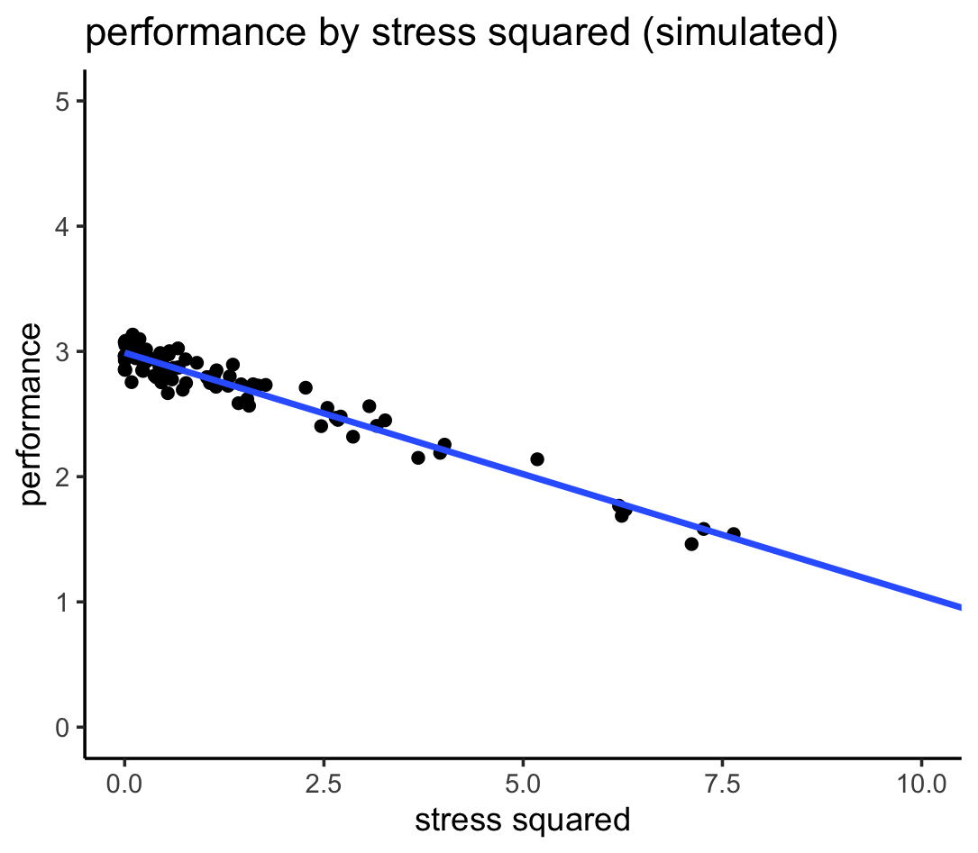
A well-known nonlinear association
OR

Slide 9
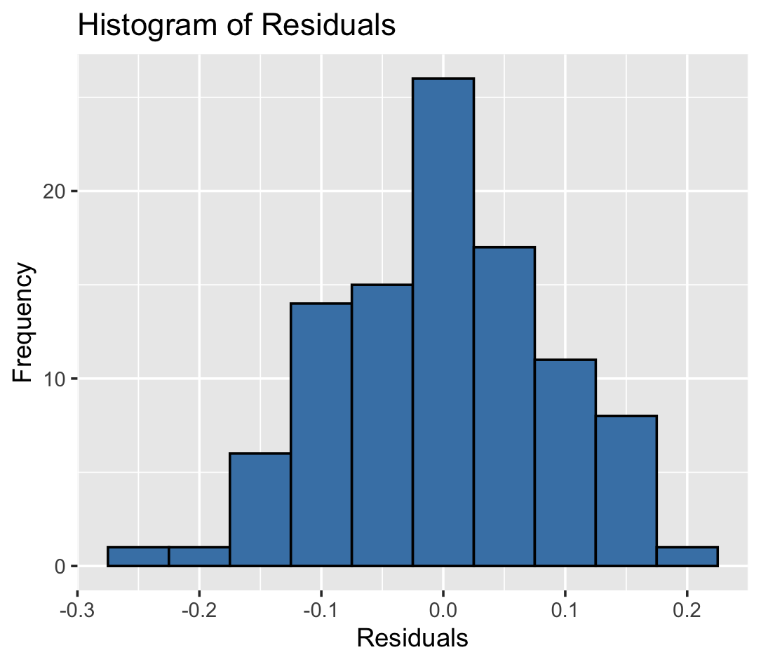
A well-known nonlinear association

Slide 10
Homoscedasticity/ Homogeneity of Variance
When testing several groups of participants, samples should come from populations with the same variance
In correlational designs, the variance of the outcome variable should be stable at all levels of the predictor variable

Slide 11
Homoscedasticity/ Homogeneity of Variance
Can affect the two main things that we might do when we fit models to data:
Parameters
Null Hypothesis significance testing

Slide 12
Homoscedasticity/ Homogeneity of Variance

Slide 13
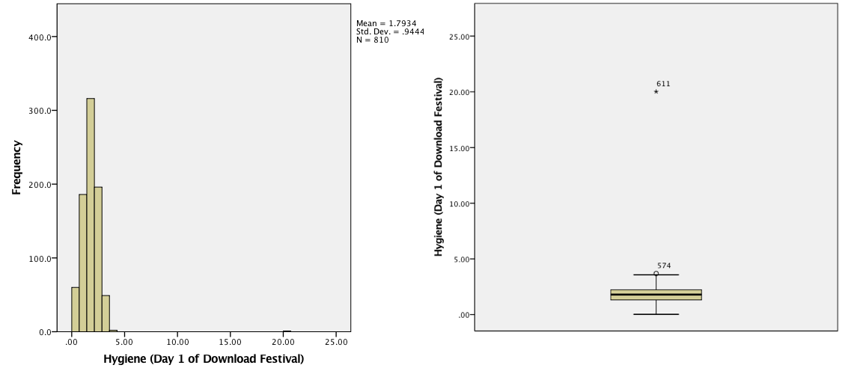
Spotting Outliers

Slide 14
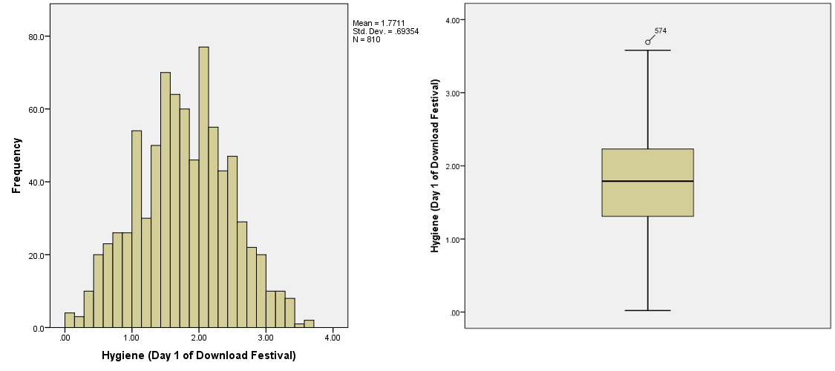
Spotting Outliers

Slide 15
Spotting Normality
Central Limit Theorem
If N > 30, the sampling distribution is normal anyway (arguably)
Graphical displays
P-P Plot (or Q-Q plot)
Histogram
Values of skew/kurtosis
0 in a normal distribution
Kolmogorov-Smirnov Test (but the result depends on N)

Slide 16
What happens when assumptions are violated?
Make an a-priori rule about identifying and eliminating outliers (e.g., +/- 3 SD from mean)
Why would it be okay to eliminate data?
Transform the data by applying a mathematical function to scores
Changes the interpretation of the association
Use Non-parametric tests (more on this later)
Changes the interpretation of the association

Slide 17
Transforming Data
Log transformation (log(x_{i}))
Reduce positive skew.
Square root transformation (√x_{i}):
Also reduces positive skew. Can also be useful for stabilizing variance.
Reciprocal transformation (1/ x_{i}):
Dividing 1 by each score also reduces the impact of large scores. This transformation reverses the scores, you can avoid this by reversing the scores before the transformation, 1/(x_{highest} – x_{i}).

Slide 18
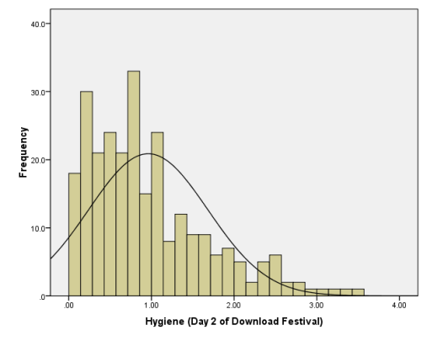
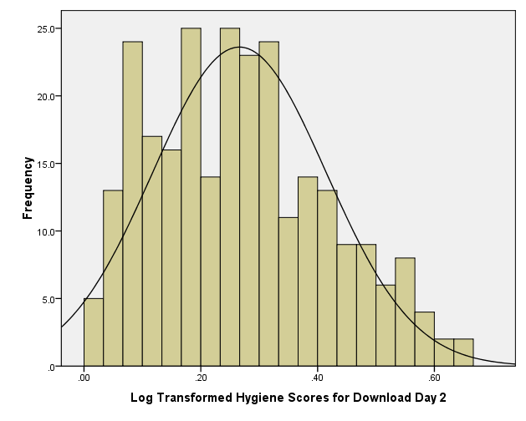
Log Transformation
Before
After

Slide 19
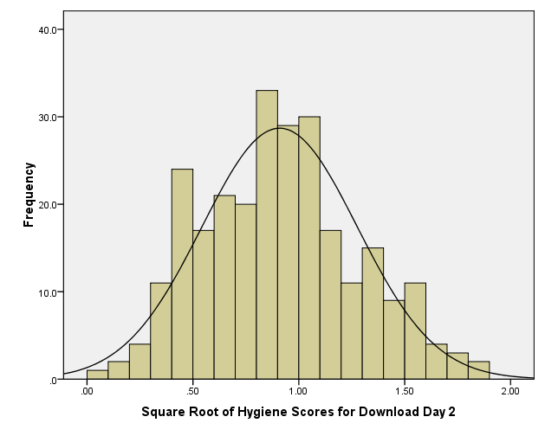
Square Root Transformation
Before
After

Slide 20
How do you decide?
Have a plan before you collect data
Plan should be based on:
Your hypotheses and what’s right for your dataset
What is typical or standard in your field
The proposed size of your sample
The robustness of your proposed effect
A systematic, thoughtful rationale

Slide 21
Data Visualization
You need to do it before you analyze your data (to check for all of the issues we just discussed!)
But also, to represent your data clearly and concisely to an audience

Slide 22
The Art of Presenting Data
Graphs should (Tufte, 2001):
Show the data
Induce the reader to think about the data being presented (rather than some other aspect of the graph)
Avoid distorting the data
Present many numbers with minimum ink
Make large data sets (assuming you have one) coherent
Encourage the reader to compare different pieces of data

Slide 23
WHAT’S
THIS
WRONG
GRAPH?
WITH

Slide 24
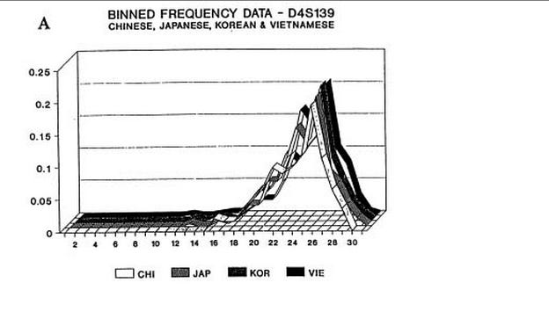
What’s wrong with this graph?
Notes:
Meaningless 3rd dimension!

Slide 25
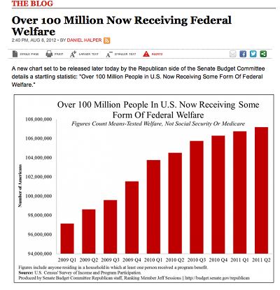
What’s wrong with this graph?
Notes:
SCALE!!
USA today is notorious for fussy graphs that have too much information and mislead. This graph makes our welfare problem look like it’s spiraling out of control. But note where the y-axis starts…at 94 million!
Fox News showed this chart of what would happen if the Bush tax cuts expired. Disastrous, right? Again, check the scale (it starts at 34). All is not what it seems.

Slide 26
What’s wrong with this graph?
Notes:
Fox News showed this chart of what would happen if the Bush tax cuts expired. Disastrous, right? Again, check the scale (it starts at 34). All is not what it seems.

Slide 27
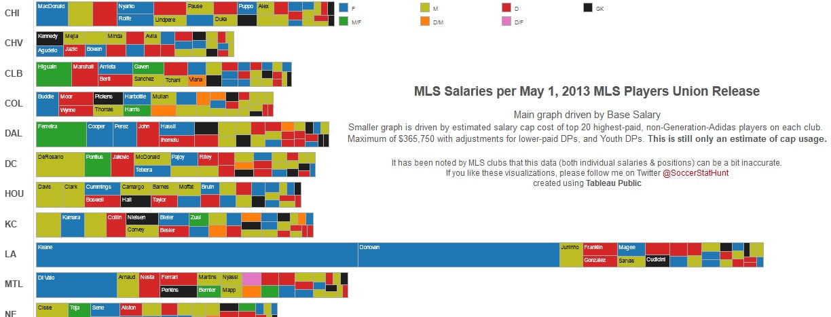
What’s wrong with this graph?
Notes:
I never thought it was possible but I actually understand soccer less after looking at this chart.

Slide 28
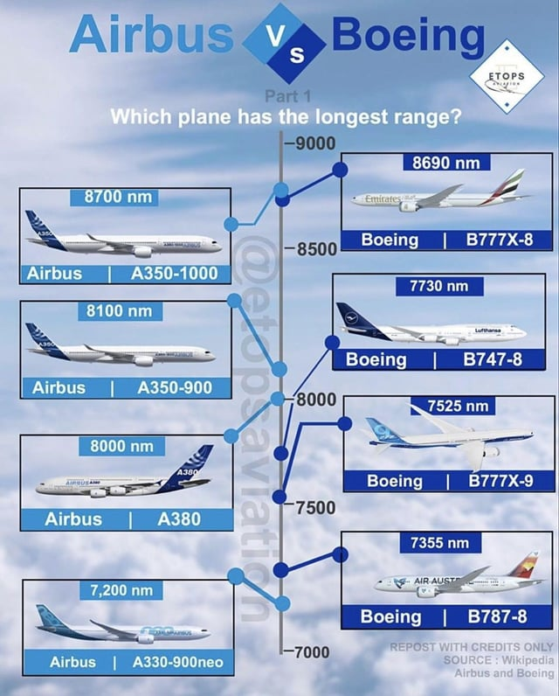
What’s wrong with this graph?

Slide 29

Watch out for accidental messages!

Slide 30
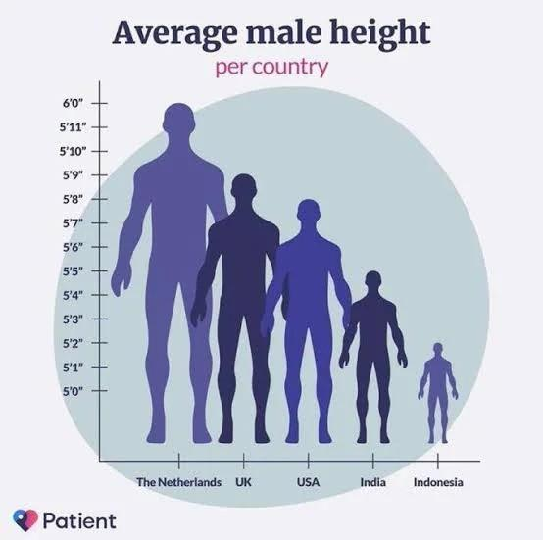
What’s wrong with this graph?

Slide 31
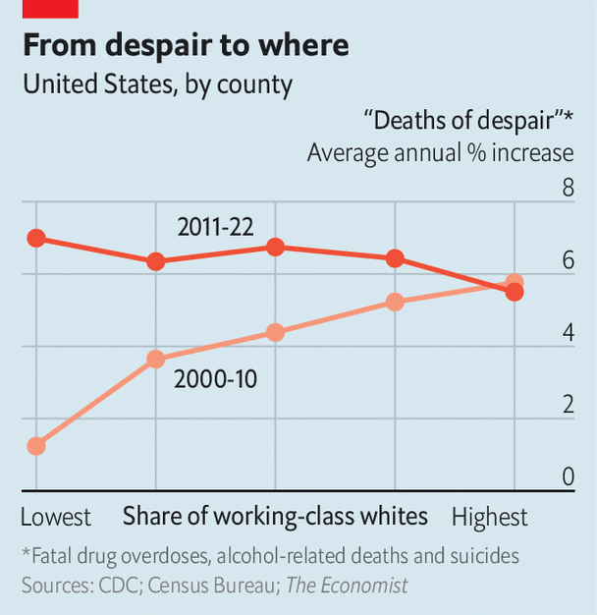
What’s wrong with this graph?

Slide 32
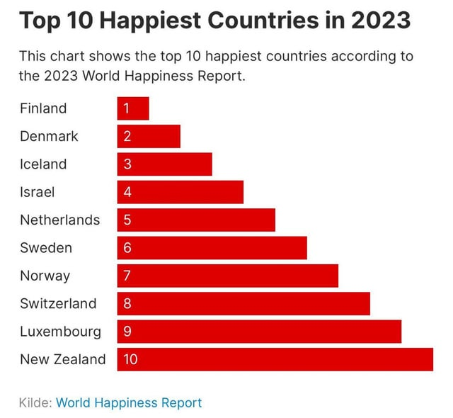
What’s wrong with this graph?

Slide 33
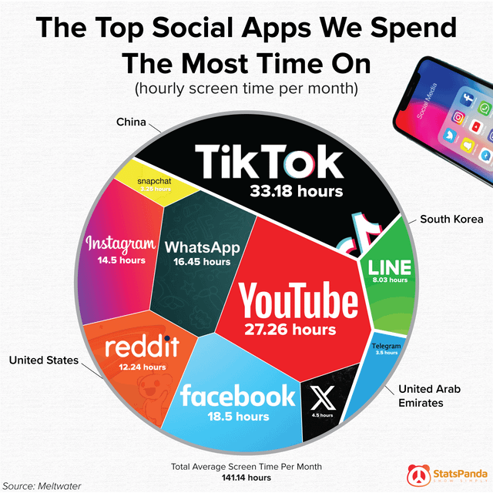
What’s wrong with this graph?

Slide 34
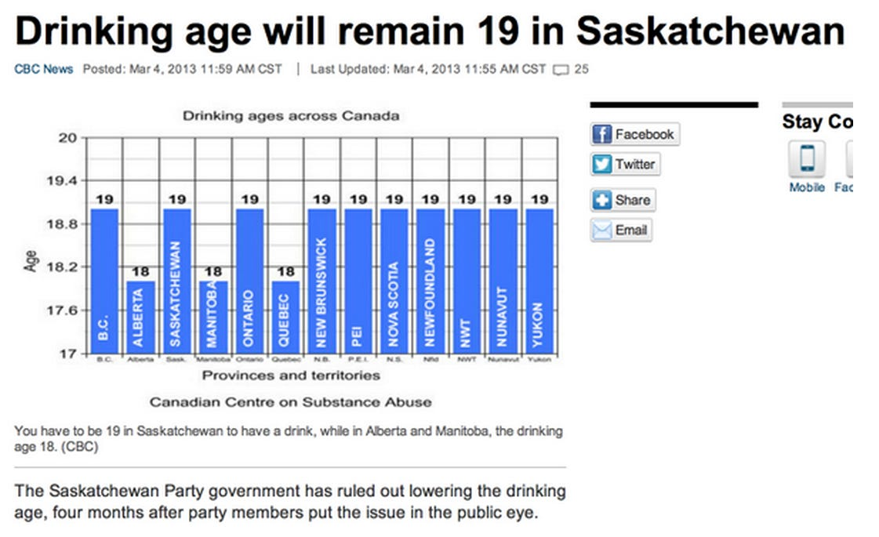
What’s wrong with this graph?
Notes:
You don’t need a graph for this. Only 3 provinces are different.

Slide 35
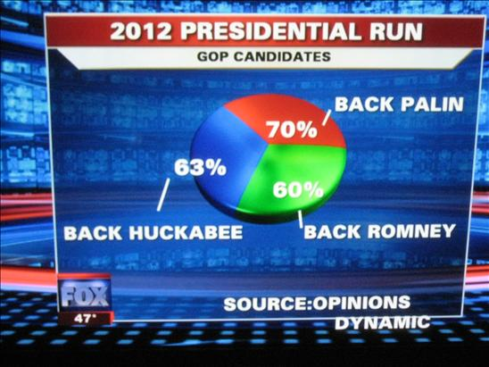
What’s wrong with this graph?
Notes:
Numbers don’t add up!

Slide 36

What’s wrong with this graph?
Notes:
No data labels! It tells us nothing!

Slide 37
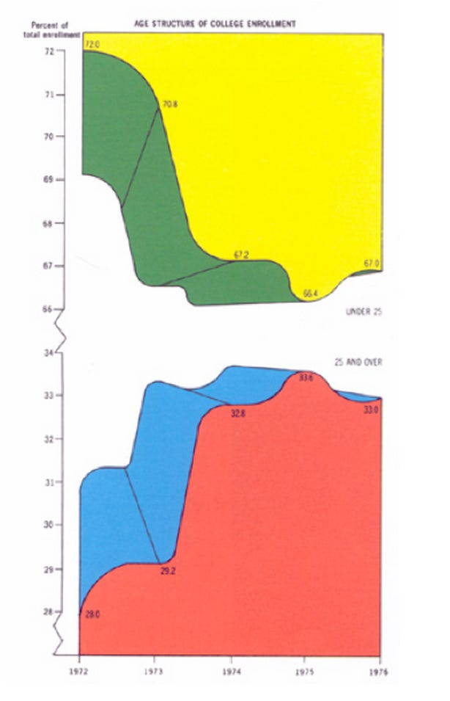
What’s wrong with this graph?
Notes:
So so much.
Edward Tufte — the guy who invented the word "chartjunk" — personally held this up as the worst chart ever. Why? The colors may induce ocular bleeding, it's in three dimensions for no reason, the Y-axis is broken twice, The chart only communicates five numbers — it's showing the breakdown of students under 25 and over 25 over 5 years — and the top section is inexplicably inverted.

Slide 38
Histograms
Histograms plot:
The score (x-axis)
The frequency (y-axis)
Histograms help us to identify:
The shape of the distribution
Skew
Kurtosis
Spread or variation in scores
Unusual scores

Slide 39
Boxplots (box-whisker diagrams)
Boxplots are made up of a box and two whiskers.
The box shows:
The median
The upper and lower quartile
The limits within which the middle 50% of scores lie.
The whiskers show
The range of scores
The limits within which the top and bottom 25% of scores lie

Slide 40
Boxplots

Slide 41
Spotting Outliers

Slide 42
Spotting Outliers

Slide 43
Error Bars in Charts
The bar (usually) shows the mean score
The error bar sticks out from the bar like a whisker.
The error bar displays the precision of the mean in one of three ways:
The confidence interval (usually 95%)
The standard deviation
The standard error of the mean

Slide 44
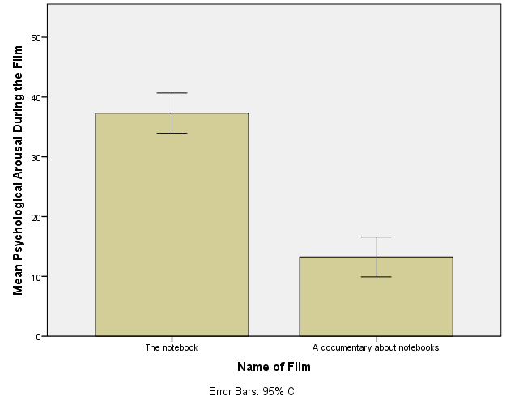
Bar Graph: One Independent Variable

Slide 45
Bar Graphs
Tells us about the relationship between two groups of variables (can be continuous or discontinuous)
Oftentimes different bars refer to different groups of people, but can also used for within-subjects designs

Slide 46
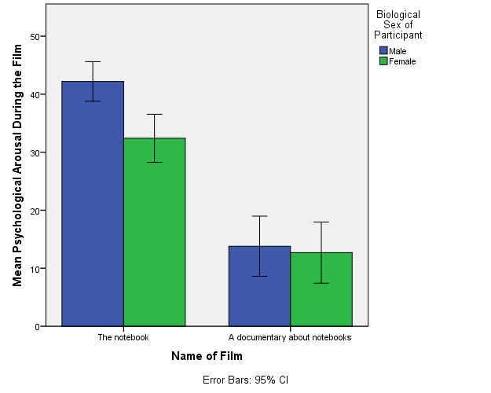
Bar Graph: Two Independent Variables

Slide 47
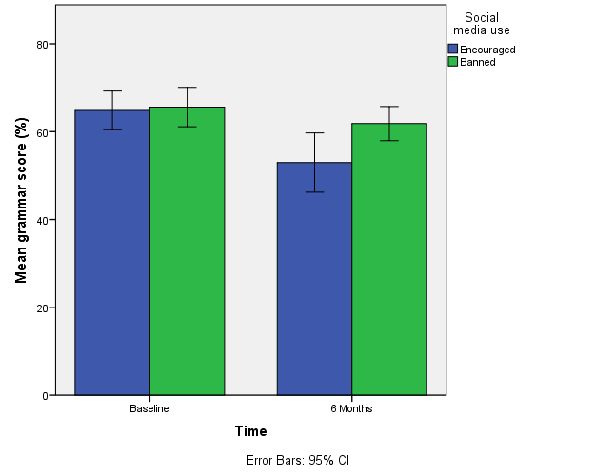
Bar Graph: Mixed Designs

Slide 48
Line Graphs
Tells us about the relationship between two variables (can be continuous or discontinuous)
The lines might be used to convey a connection between points (e.g., the same subjects in each condition), so this approach can be more effective for a within-subject design

Slide 49
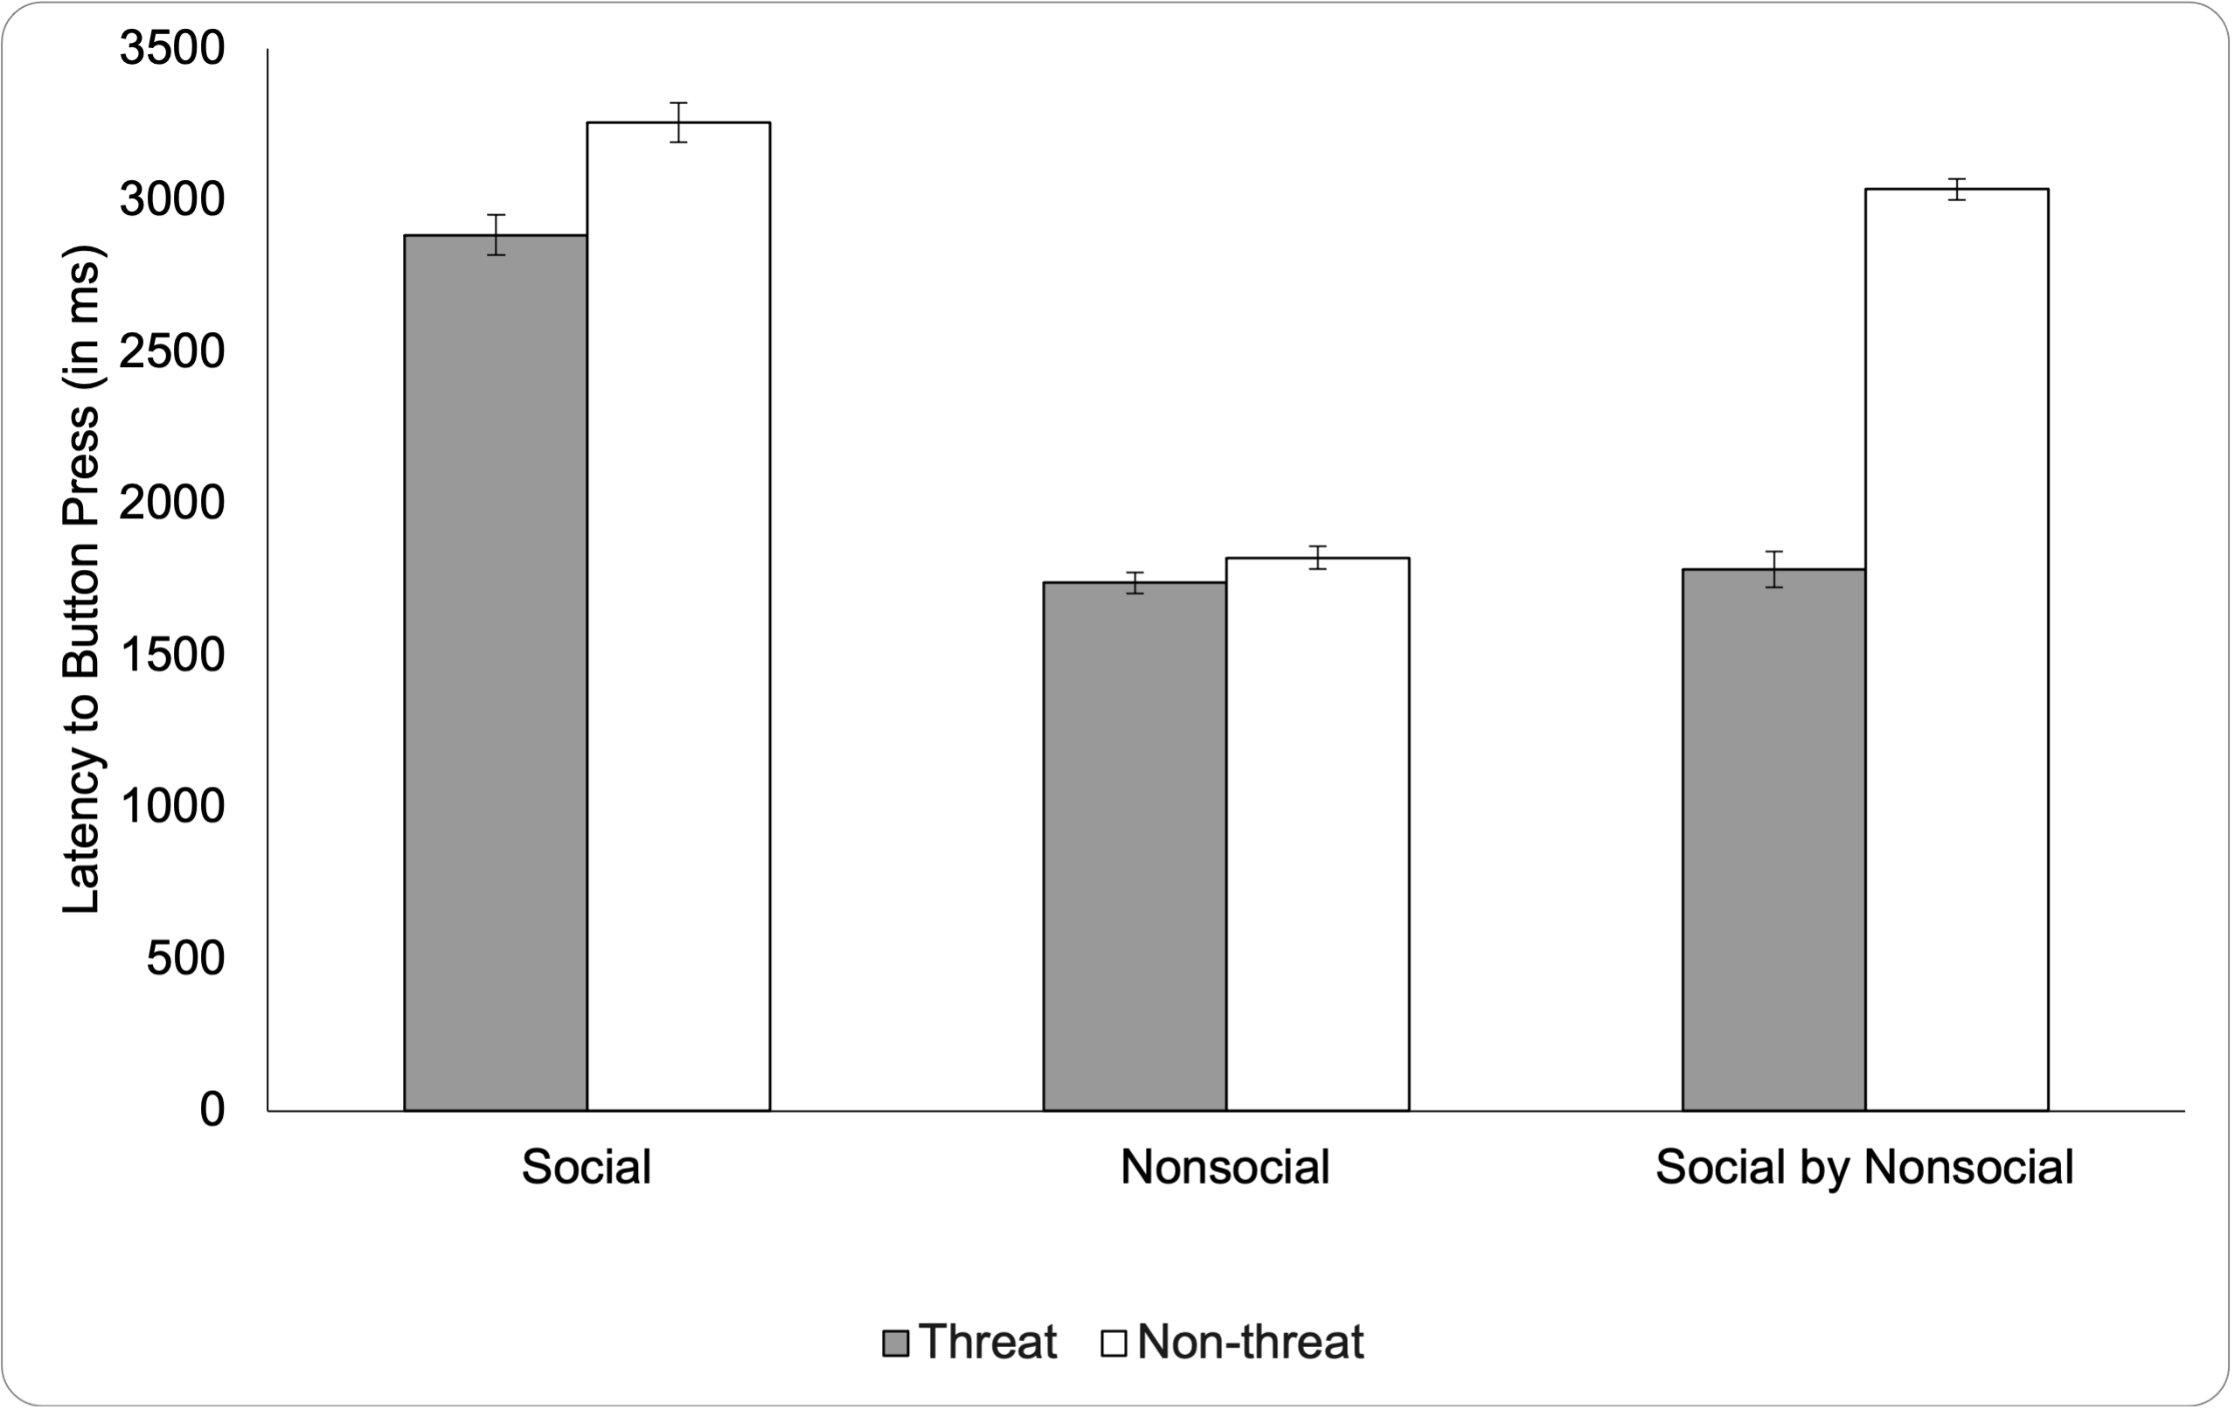
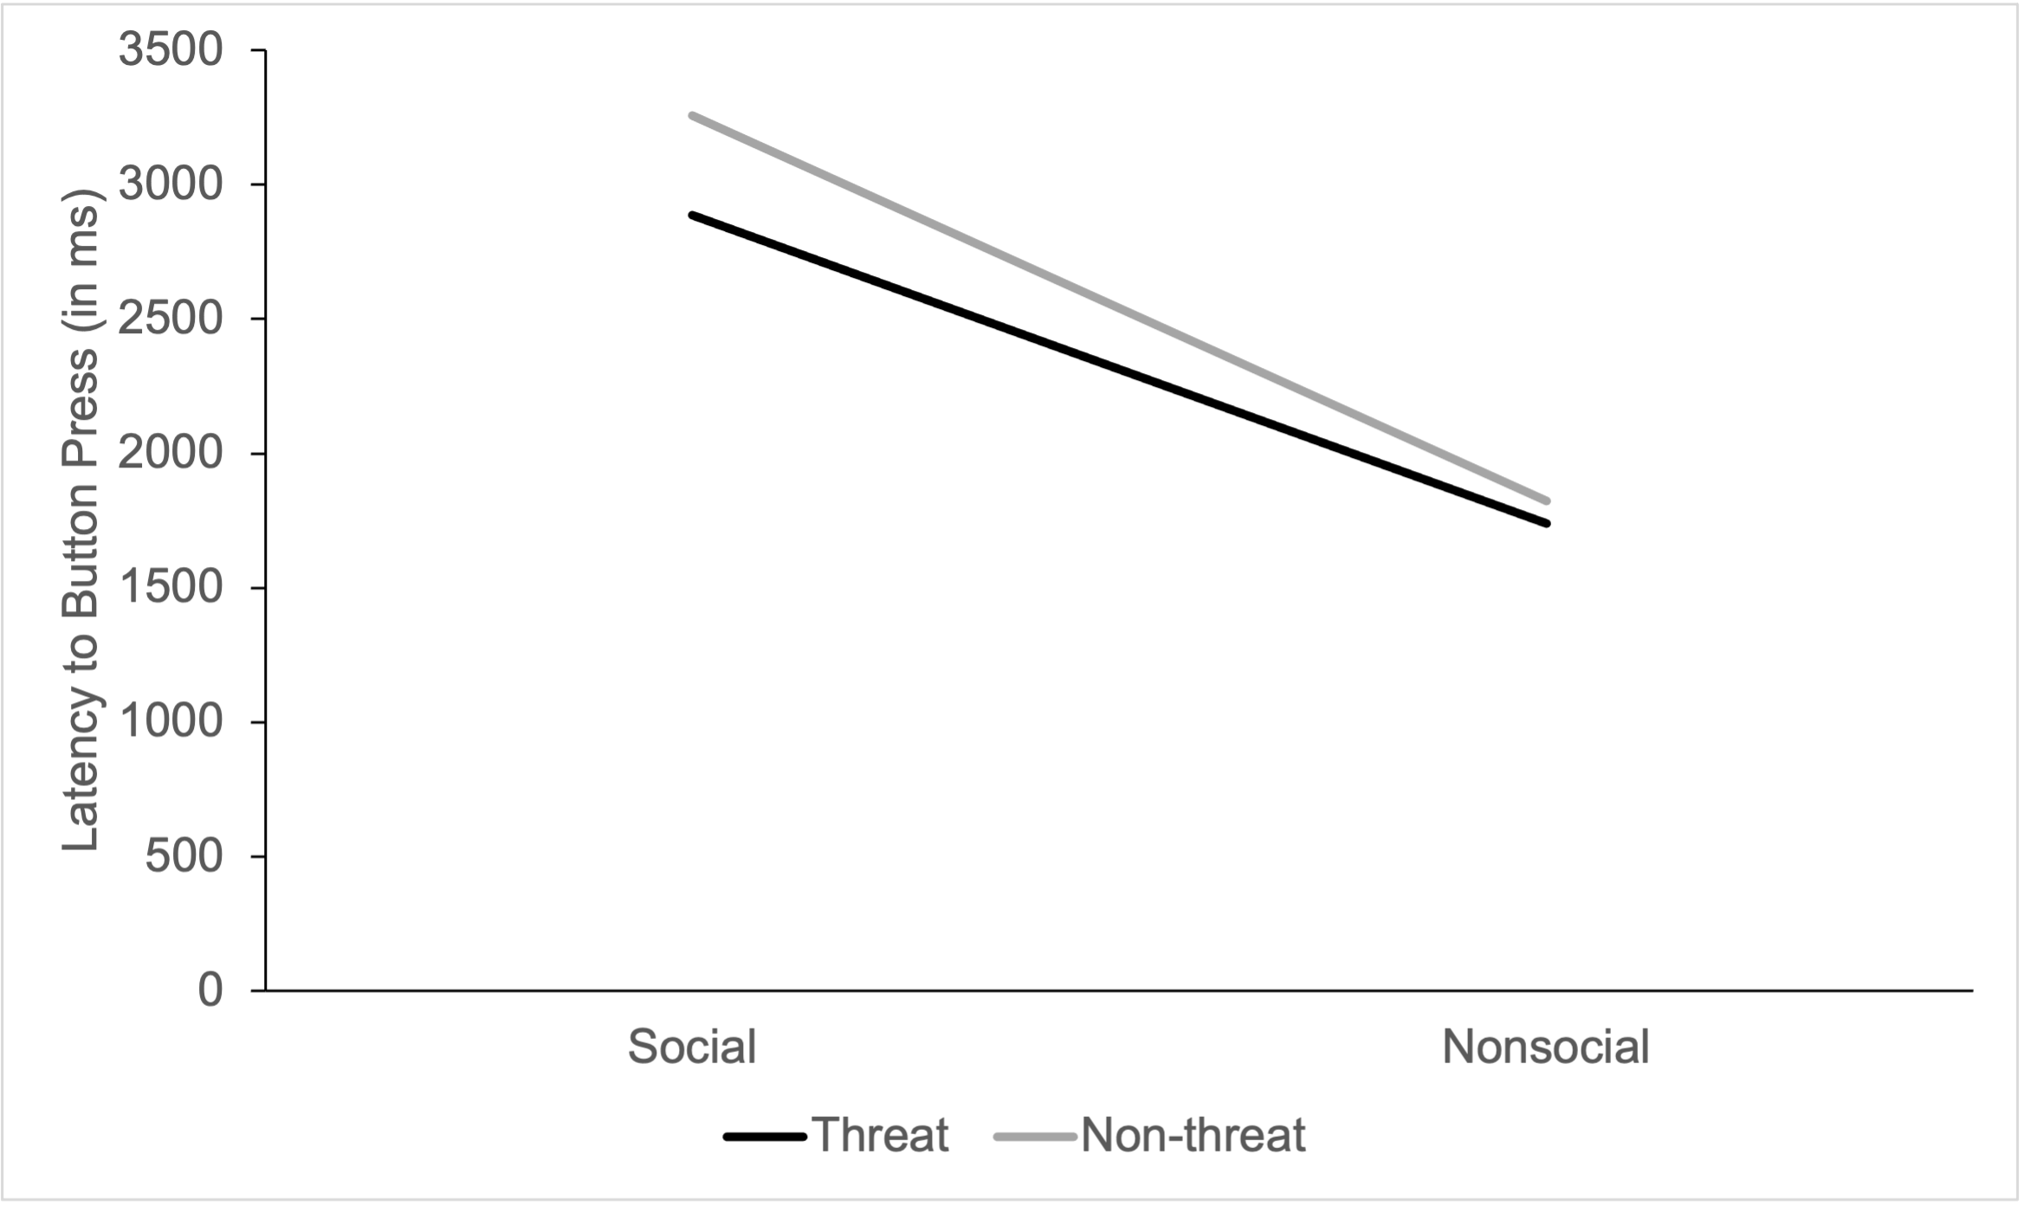
Line Graphs
Notes:
From my own data

Slide 50
Scatterplots
Tells us about the relationship between two continuous variables

Slide 51
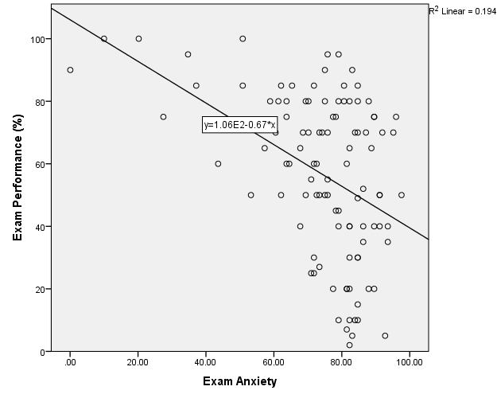
Simple Scatterplot

Slide 52
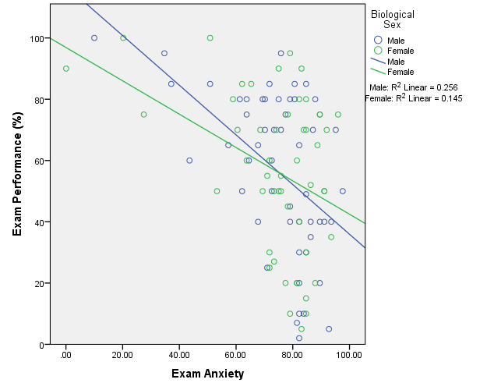
Grouped Scatterplot

Slide 53
Matrix Scatterplot

Slide 54
Some Basic Guidelines
Know your audience
Identify your message

Slide 55
Some Basic Guidelines
Know your audience
Identify your message
Adapt the figure to the support medium
Do not trust defaults

Slide 56
Some Basic Guidelines
Know your audience
Identify your message
Adapt the figure to the support medium
Do not trust defaults
Use color effectively

Slide 57
Use Color Effectively

Slide 58
Some Basic Guidelines
Know your audience
Identify your message
Adapt the figure to the support medium
Do not trust defaults
Use color effectively
Captions are not optional
Do not mislead the reader

Slide 59
Do not mislead the reader
Notes:
Scale should have the max that you can measure.

Slide 60
Captions (and labels) are not optional!
Notes:
No data labels! It tells us nothing!

Slide 61
Some Basic Guidelines
Know your audience
Identify your message
Adapt the figure to the support medium
Do not trust defaults
Use color effectively
Captions are not optional
Do not mislead the reader
Avoid “chartjunk”

Slide 62
Avoid chart junk!
Notes:
Example from the book

Slide 63
Avoid chart junk!

Slide 64
Message trumps beauty

Slide 65
Message trumps beauty

Slide 66
Some Basic Guidelines
Know your audience
Identify your message
Adapt the figure to the support medium
Do not trust defaults
Use color effectively
Captions are not optional
Do not mislead the reader
Avoid “chartjunk”
Message trumps beauty
Get the right tool

